Slide 1
E-COMMERCE
Business content' in SAP Business Information Warehouse
Presented by MD ABDUS SAHID

Slide 2
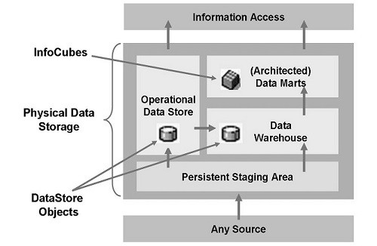
SAP BW (Business Warehousing)
Definition or Meaning- What is SAP BW?
Full form or SAP BW stands for (Business Warehousing), a highly robust and scalable real-time data warehousing platform that
captures, stores and consolidates vital
information, is the first choice for
organizations looking for accelerated
operations. SAP Business Warehouse,
supercharged by SAP HANA, offers
decision-ready intelligence for businesses
and powers the data warehouse environment with simplified administration tasks, reduced IT workloads and a lower TCO. With real-time access to credible information, this widely used SAP module is used as an ERP tool and was earlier known as the Business Information Warehouse.

Slide 3
What is Operational Data Store (ODS)?
It is operational data store. ODS is a BW Architectural component that appears between PSA ( Persistant Staging Area ) and infocubes and that allows Bex ( Business Explorer ) reporting. It is not based on the star schema and is used primarily for details reporting, rather than for dimensional analysis.
ODS objects do not aggregate data as infocubes do. Data are loaded into an IDS object by inserting new records, updating existing records, or deleting old records as specified by RECORDMODE value.

Slide 4
SAP BW Info cube Dimension Tables
We are using the RSRV transactiondata test named "Entries Not Used in the Dimension of an InfoCube" to clean up unused entries in a BW infocubes dimensiontable.
The program ZSAP_DIM_CLEANER takes 3 parameters and 2 checkmarks.
Parameters:
PCUBE is the technical name of the cube (e.g. ICUB),
PDIM is the dimension of that cube you want to clean up (e.g. ICUB3, which is dimension 3 of cube ICUB) and

Slide 5
PSIZE is the number of rows you want to delete in 1 paket . After 1 paket is DELETEd , a COMMIT is issued and the next paket is DELETEd. Flags: REPAIR when checked really does DELETEd , when unchecked, just checks and shows you the result. No problem to uncheck this and just run to get an idea how long reading may take. DEBUG when checked stops before the read and delete is done so you have a chance to follow the details. The program is very small and can easily be understood. Take a look and discuss with your DBA for questions.

Slide 6
Defining a Logical System
Use The purpose of this activity is to create a logical system for your systems. To enable communication between systems within your system landscape, you must 1. Define the systems as logical systems. 2. Assign the logical system to your client. This enables the systems to recognize the target system as an RFC destination. If the logical system has already been created, skip this activity. Logical systems are defined cross-client.

Slide 7
Procedure Carry out the following steps: 1. Access the transaction using: Transaction Code SPRO SAP IMG Menu SAP NetWeaver → Application Server →IDoc Interface / Application Link Enabling (ALE) → Basic Settings → Logical systems → Define Logical System 2. Choose New entries. 3. In the column Log System, enter a name for the logical system that you want to create. 4. In the column Name, enter a description of the logical system. Log. System Name <Logical system 2>, for example DS7CLNT723 Your System

Slide 8
To designate logical systems, apply the naming convention <XXX>CLNT<NNN> where XXX is the system name and NNN is the client. 5. Save your entries. A transport request for Workbench appears. 6. Select an existing request or create a new request, if necessary. A transport request for Customizing appears. 7. Select an existing request or create a new request, if necessary.

Slide 9
Error Reading the Data of Infoprovider , database error 258
Insufficient Privilege Query failure in BW
Following error message is coming When we run a BW query
Insufficient privilege: Not authorized
Error 258 has occurred in the BWA/SAP HANA server Error reading the data of InfoProvider XXXXXX Error while reading data; navigation is possible Row: 59 Inc: MAP_TREX_EXCEPTION Prog: CL_RSDRH_TREX_STORAGE

Slide 10
In dev log, you could find information as listed.
C SQLCODE : 258C SQLERRTEXT : insufficient privilege: Not authorized C sc_p=1147cab88,no=201,idc_p=(nil),con=0,act=0,slen=108,smax=256,#vars=3,stmt=116b7bdd0,table= C CALL SYS.TREXviaDBSLWithParameter( ? , ? , ? , 'ROUTE_BY_TABLES("SAP<sid>"."0BW:BIA:<sid>:XXXXXX C D" )' ) ;

Slide 11
Solution:
Above error you are getting because as SAP<sid of BW system> user has insufficient privilege to execute TREXVIADBSLWITHPARAMETER.
Kindly follow the below steps:
Goto HANA Studio, add the following SQL object on the tab "SQL Privileges": TREXVIADBSLWITHPARAMETER (SYS) and select "EXECUTE" with "No" for grantable to others

Slide 12
thank you

